Slide 1
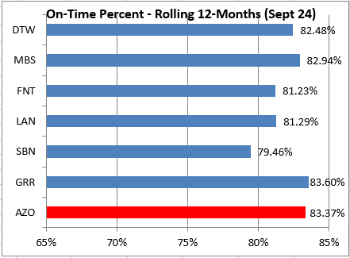
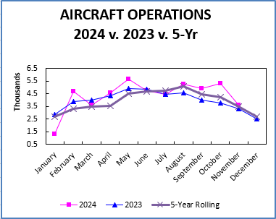
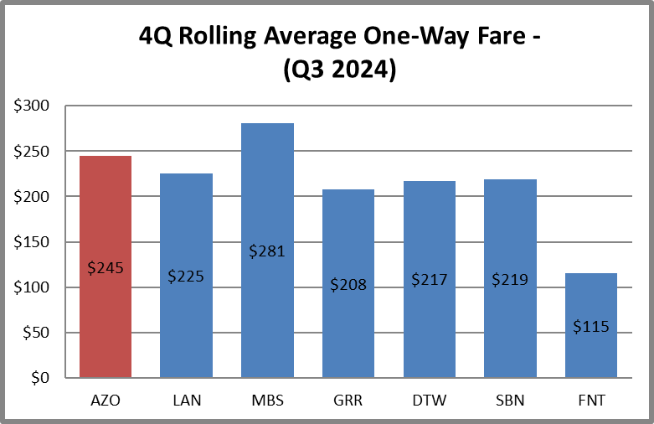
Kalamazoo/Battle Creek International Airport Monthly Statistics – January 2025
Notes:
Average Fared Fare in Q3 2023 was $214. You can see the difference Avelo had in driving that down with the MCO fare.

