Slide 1

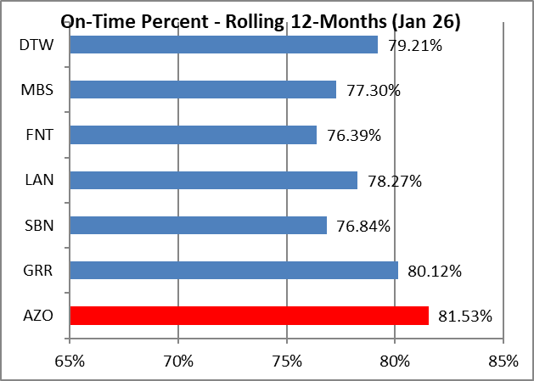
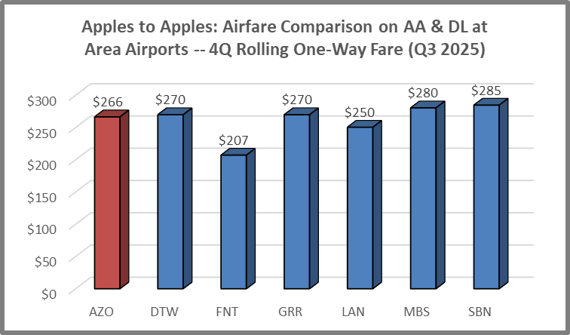
Kalamazoo/Battle Creek International Airport Monthly Statistics – April 2026

