Slide 1
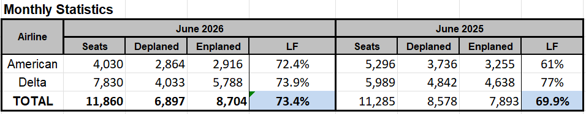
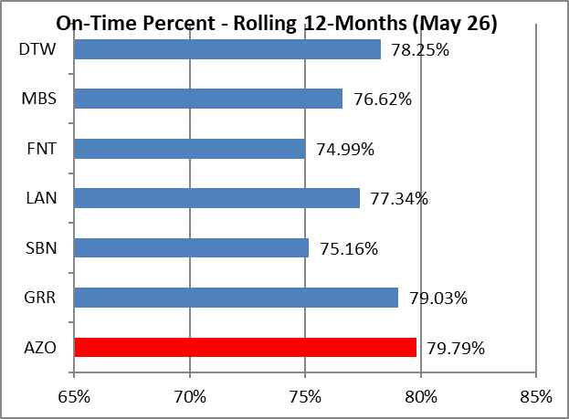
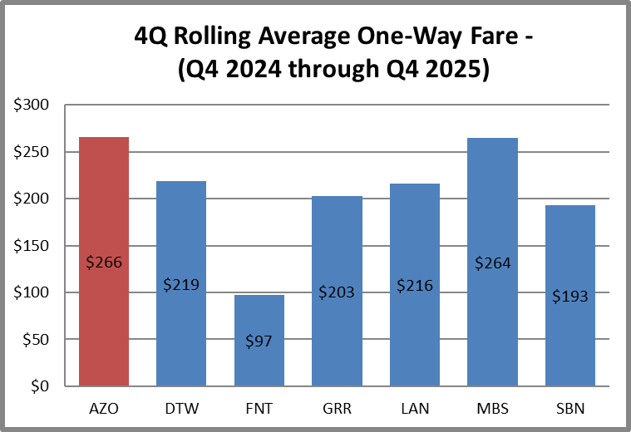
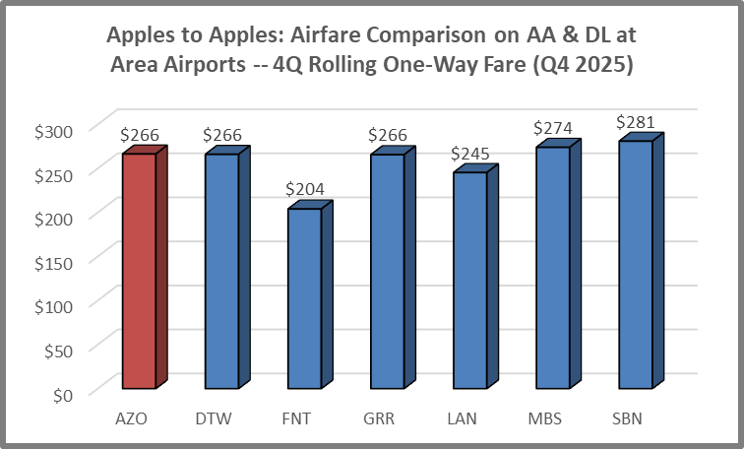
Kalamazoo/Battle Creek International Airport Monthly Statistics – June 2026
Notes:
"Passenger traffic increased 24.8% year over year as airlines expanded available seating by 30.7%. While more travelers flew in 2026 than in 2025, the additional capacity outpaced demand, resulting in a load factor of 73.9% compared with 77.4% the previous year. On a capacity-adjusted basis, demand was approximately 4.5% lower than the prior year."
This analysis shows that:
Actual passengers: ▲ 24.8%
Available seats: ▲ 30.7%
Load factor: ▼ from 77.4% to 73.9%
So unlike your first example—where demand strengthened despite fewer seats—this example shows that passenger growth was driven primarily by increased airline capacity, with aircraft flying slightly less full on average.

